Slide 1
Strategic Business Exit : Insights
Steve Cramer
(843) 568-4747
stevecramer1164@gmail.com

Slide 3
E B I T D A

Slide 4
Timeline

Slide 5
Prepping

Slide 6
Broker and Contract

Slide 7
Broker Compensation

Slide 8
Employee Retain Plan

Slide 9
Employee 2

Slide 10
Value and Adjusted EBITDA

Slide 11
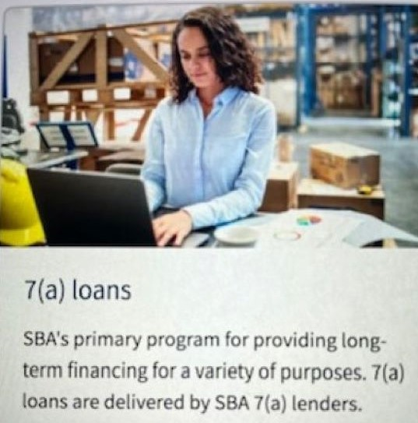
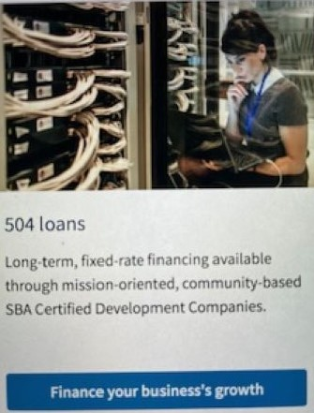
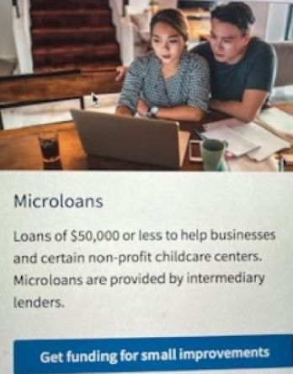
SBA Funding

Slide 12
SBA, BANKS AND PRIVATE EQUITY

Slide 13
SBA, BANKS AND PRIVATE EQUITY PAGE 2

Slide 14
Resources

